Slide 2

Unit 1
Introduction to
Oxygen Therapy,
Invasive and Non-invasive Mechanical Ventilation
Sherri Katz MDCM, MSc, FRCPC
Children’s Hospital of Eastern Ontario

Slide 3

Objectives
11337 - List the key respiratory parameters that can be controlled with a ventilator, and explain how these parameters are affected by the patient’s underlying respiratory system physiology.
11335 - List the indications for mechanical ventilation, and outline when oxygen therapy, invasive ventilation, and non‐invasive ventilation should be used for a patient in acute or chronic respiratory failure.
12106 - Define mechanical ventilation and the terms “invasive ventilation” and “non‐invasive ventilation”.

Slide 4
Objectives
11336 - Describe the advantages and disadvantages of invasive and non‐invasive ventilation.
11338 - Explain how positive airway pressure therapy works to treat obstructive sleep apnea, briefly explain the difference between constant airway pressure support and bi‐level support, and briefly describe the different types of patient interfaces available for patients on positive airway pressure therapy..
12105 - Recognize the indications, results, and complications of home O2 therapy, including the pathophysiology of CO2 narcosis and the need for controlled flow O2 therapy, and describe how supplemental oxygen may be delivered in the home.

Slide 5
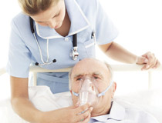
Oxygen Therapy
O2 is a drug!
No other drug is administered as frequently as oxygen
It is a drug with its own indications, contraindications, dosages and potential for toxicity.
Indications
Hypoxemia: lower than normal PaO₂
Myocardial Compromise: ischemia/arrhythmias
Increased Work of Breathing: use of accessory muscles

Slide 6
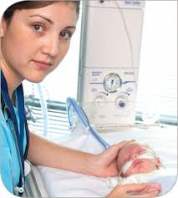
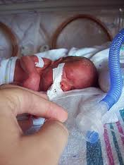
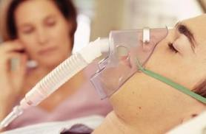
Oxygen Therapy
Oxygen Concentration of room air is 21%
Fraction of Inspired Oxygen (FIO₂ ) of room air is 0.21
Oxygen therapy can be delivered with FIO₂ > 0.21-1.00
Supplemental oxygen may be delivered to spontaneously breathing or mechanically ventilated patients.

Slide 7
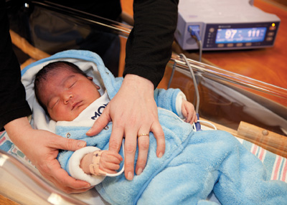
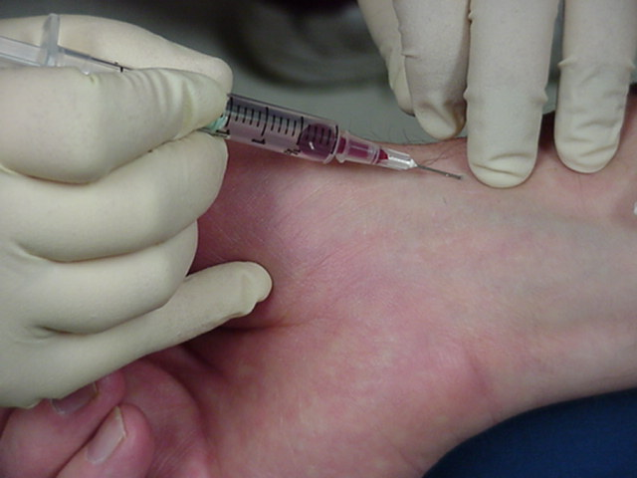
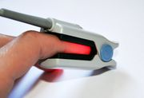
Assessment of Oxygenation
Non-Invasive Monitoring
Clinical assessment of patient colour, alertness and function
Pulse Oximetry (rest, exercise or night)
Invasive Monitoring
Blood gas sampling (arterial, venous or capillary)
This is how you monitor the O2 you give pts! Arteriole blood gas is the best but painful!

Slide 8
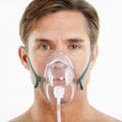
Oxygen Delivery Systems
Supplemental oxygen may be delivered via low flow or high flow systems.
Low Flow Systems
Don’t meet all of the patient’s inspiratory flow demands. Room air is entrained to make up the difference
Room air
Room air
Oxygen via tubing
Doesn’t make up all of the patients breathing demands! Not tightly fitting! Not all air breathed is the o2 you give them! Some of it is room air! So they are breathing mixed air!
Notes:
Yes, he would need to entrain more room air to meet increased flow demand.

Slide 9
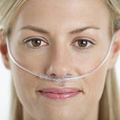
Oxygen Delivery Systems
Low Flow Systems
FIO₂ delivered is generally less than 0.40 and is a function of set oxygen flow rate, patient’s respiratory rate and tidal volume
Common examples include nasal prongs and simple mask (hint: they use small bore tubing)
3 things affecting air breathed
Pt is getting more air, his fio2 WILL GO DOWN!! They are breathing more of the room air because they are breathing more. The air from the tube hasn’t changed, so they are kinda diluting it down now
Mr. Breathless is on O₂ via NP at 4 L/min.
He becomes more short of breath and takes deeper breaths, increasing his tidal volume.
Would this affect FIO₂ delivered?
The tube actually is giving 100%, but only about 40% of it is actually breathed (Still higher than the 21% in room atm
Notes:
Yes, he would need to entrain more room air to meet increased flow demand.
9

Slide 10
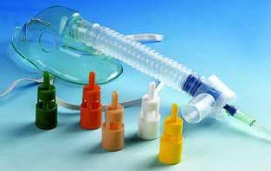
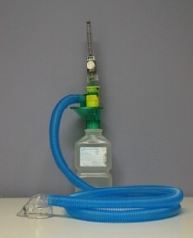
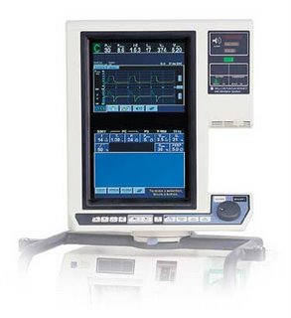
Oxygen Delivery Systems
High Flow Systems
Designed to meet patient’s inspiratory flow demand
All inspired gas is from the delivery system and FiO₂ should be constant.
Both the Total Flow and the FiO₂ delivered may be controlled by one of the following:
Mask (Venturi/Entrainment) with FIO₂ 0.24 – 0.50
Nebulizer Entrainment Setting with FIO₂ 0.28-0.98
Ventilator with FIO₂ .21-1.00
If you want to meet what pt needs → you need a HIGH flow system! In this case, you can control a bit bette rhow much O2 is given → it controls how much is mixed! If pt starts breathing more, the machine will give more O2. Only way you get 100% O2 is if patient is I a closed loop, which is a ventilator!

Slide 11
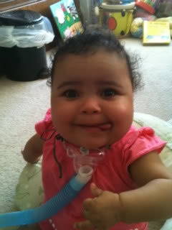
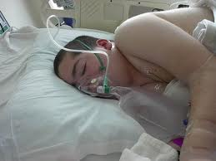
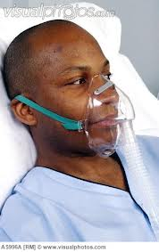
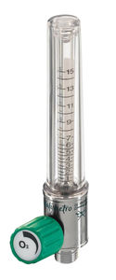
Oxygen Delivery Systems
High Flow Oxygen Delivery Systems
Must be powered by high pressure oxygen source and a minimum of 10-15 L/min oxygen flow.
Non-rebreather Mask
Reservoir bag must remain inflated during entire respiratory cycle to ensure adequate flow and constant FIO₂
(0.90 – 1.0)
Aerosol Mask
Trach Hood
Oxygen flow rate and nebulizer entrainment setting for aerosol delivery determine total flow and FIO₂ delivered (0.28 – 0.98)
If you are breathing with high flow rate: you have a high flow O2!! → you can do a high flow oxygen delivery by these 3 methods!! → if pt needs more O2, the machine will give

Slide 12
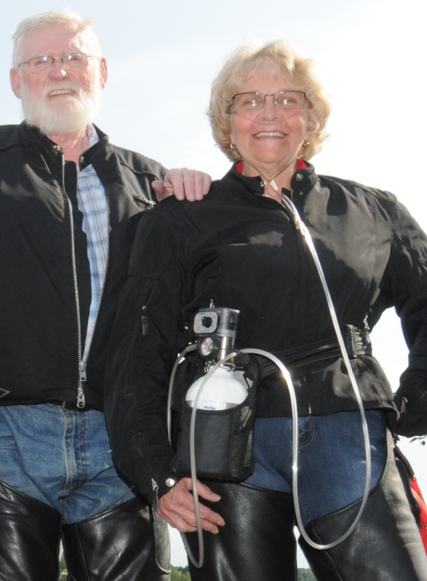
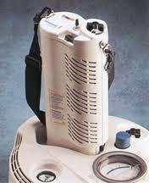
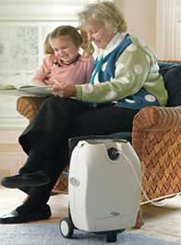
Home and Portable Oxygen Therapy
Compressed Gas Cylinders | Liquid Oxygen | Oxygen Concentrators
Large or smaller portable supply systems Increased risk due to high pressure (> 2200 psi) Smaller tanks used in carts , under strollers or mounted on wheelchairs | Oxygen stored in liquid state to maximize supply Base unit in the home with outlet to refill portable system Low pressure and lightweight | Electrical power supply to unit that draws in room air and “concentrates” oxygen Must have backup cylinder or liquid supply Base unit and portable concentrators available
Can be used for pts at home, or walking around! There are smaller and larger O2 tanks! Very very very high pressures, can be dangerous! You can also have O2 in liquid form (lighter, and you can refill it! But you are time limited with liquid. 3rd option is like a vacuum, it takes O2 from atm. Pts will normally use a mix of these 3

Slide 13
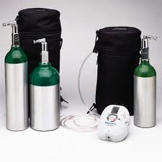
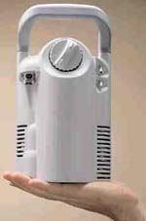
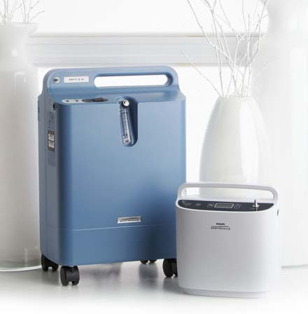
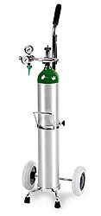
Home Oxygen Delivery Systems
Oxygen Concentrators
Portable Compressed
Oxygen Cylinders
Portable Liquid Oxygen Supply

Slide 14
Complications of Oxygen Therapy
Oxygen toxicity
Free radicals
E.g.. Retinopathy of Prematurity
CO2 Narcosis
Occurs in patients with chronic hypercapnia who are given supplemental oxygen
Less sensitive to CO2 to drive respiration and are “driven” by hypoxemia to breathe → suppression of respiratory centre with supplemental O2 → PaCO2 increase → respiratory acidosis, somnolence
Alternative Mechanism in COPD: reversal of pulmonary vasoconstriction and increased dead space ventilation
O2 can be dangerous too! Especially in premature babies!
Happens in chronic hypercapnia, and when we give them O2, the person will stop breathing as much, and the CO2 will increase!!!
Another theory: O2 is a vasoconstrictor so when you give pts O2, you will vasodilate the arteries, now areas are very well perfused but no O2 is going MEH

Slide 15
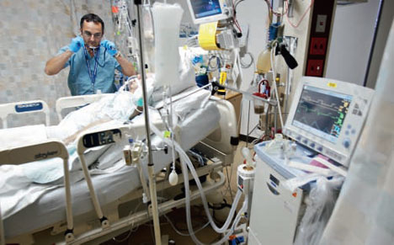
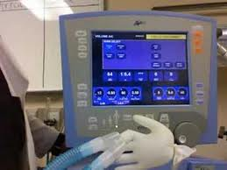
Mechanical Ventilation: Definition
Mechanical Ventilation is the use of a mechanical device to assist or accomplish gas exchange between the lungs and the outside world
Notes:
Instructions on applying the footer to all slides at once can be found here: http://www.medicine.uottawa.ca/medtech/eng/documentation_ppt_footer.html

Slide 16
Why Mechanically Ventilate People?
Indications
Respiratory Arrest (apnea)
Acute Respiratory Failure (hypoxemia, with or without hypercarbia)
Impending Respiratory Failure (increased work of breathing – fatigue)
Iatrogenic Respiratory Failure (anesthesia, sedation)
Alleviate Airway Obstruction (stenosis/edema)

Slide 17
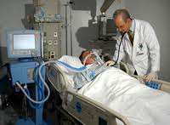
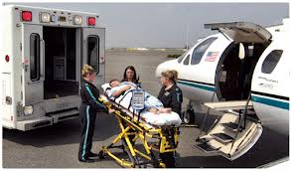
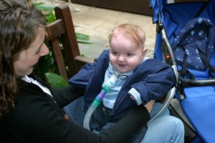
Where Do People get Ventilated?
Acute Care
Intensive Care Units
Emergency Departments
Operating Rooms
Medical Transport (land/air)
Chronic (or Long-Term) Care
At home
Long-term care facilities
(including hospitals)
People can also take ventilators at home!

Slide 18
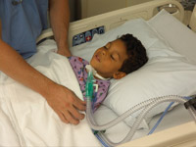
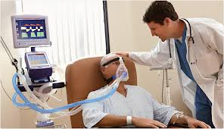
How are patients ventilated?
Invasively | Non-invasively
Endotracheal/Tracheostomy Tube | Mask Interface
Advantages: secure airway, closed system, better oxygen delivery, direct monitoring of airway pressure and lung mechanics. Disadvantages: discomfort, need for sedation, risk of pneumonia because bypasses normal airway defenses, mucosal trauma, mucus plugs | Advantages: comfort, less risk of infection /complications, reduced need for sedation. Ideal for patients who only require nocturnal support. Disadvantages: mask fit, leaks in system may compromise ventilation and oxygenation.
Whether there is a direct connection between trachea and outside world, or ajust a mask!
There ar epros and cons for both: an invasive method is used if pt would be in danger if they stopped getting o2. But awake pt would not like this at all! Risk of pneumonia (cant cough). Tracheostomy, you can talk!
- Non invasive, it is much tighter than the previous masks we talked about. Not closed system (don’t know what youre delivering), but more comfortable

Slide 19
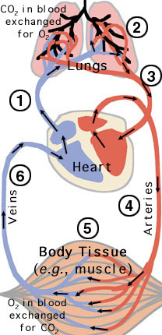
Goals of Mechanical Ventilation
Regardless of what you use, the goal is the same
Maintain tissue oxygenation and remove carbon dioxide
Acid Base Balance
Support or replace normal ventilatory pump
Moves air in and out of lungs, or “ventilates”
Provide sophisticated life support in acute care setting (potentially reversible disease) and long-term care (progressive disease)

Slide 20
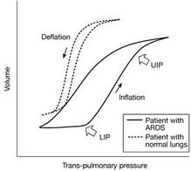
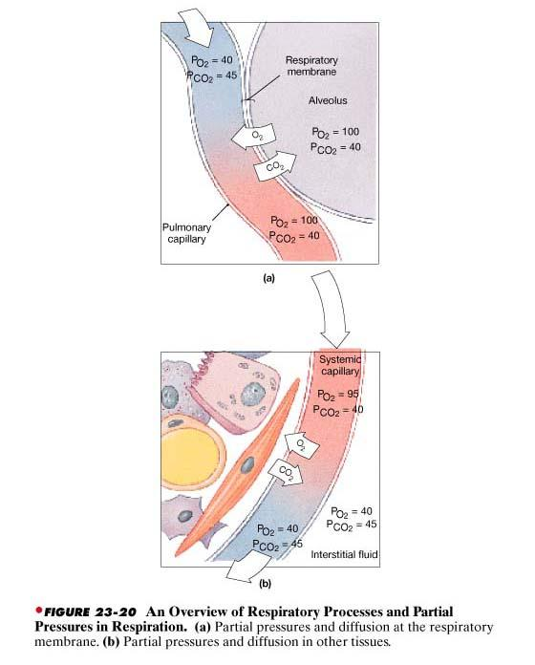

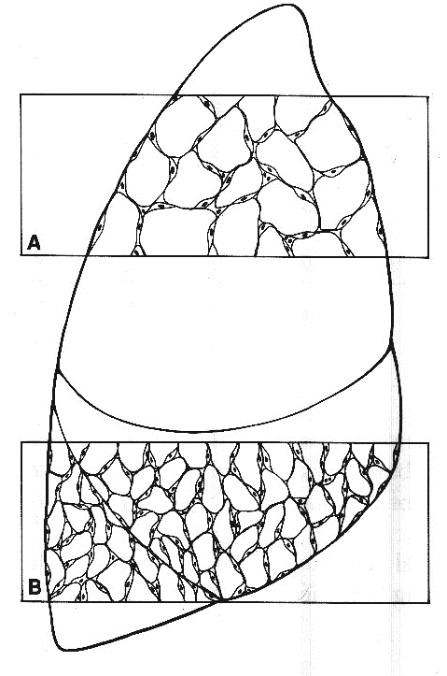


Mechanical Ventilation: What to consider...
External and Internal Respiration
Alveolar Ventilation
Mechanical Ventilation
Lung Compliance
Airway Resistance
O₂ Delivery to AC Membrane
Diffusion at AC Membrane
O₂ Delivery to Tissues
Cardiac Output
PaO₂ and CaO₂
Ventilation and Perfusion Matching
Must make sure lung compliance is high
And make sure there is reduced air rresistance
Make sure there is good vq ratio (or else youre wasting o2)
Make sure O2 is actually being delivered to tissues (heart is pumping well)
Notes:
Important to recognize many aspects and considerations. Minimize dead space (ventilation with no perfusion), overcome resistance to flow (in and out of lungs) and recruit collapsed alveoli to minimize shunting.
Ventilator must work to provide alveolar ventilation in the most efficient, lung protective strategy possible in order to support both internal/external respiration.

Slide 21
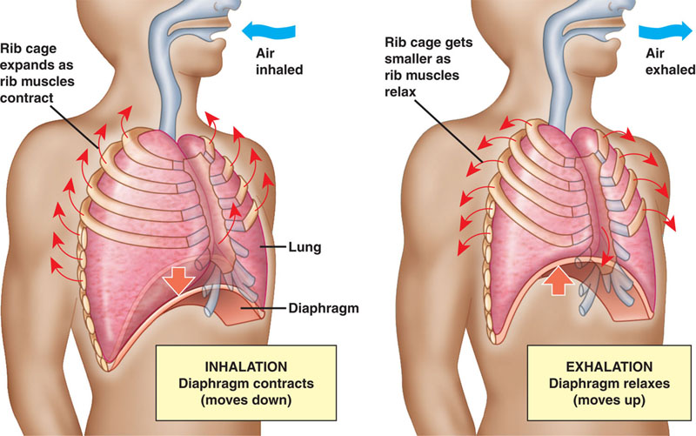
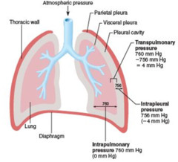
Mechanics of Spontaneous Breathing
As diaphragm moves down and rib cage expands, a negative pressure gradient develops as intrapleural pressure decreases below the atmospheric pressure at airway opening.
Air flows into the lungs.
As diaphragm relaxes it moves up reducing thoracic volume and increasing intrapleural pressure.
Air flows out of the lungs.
Negative pressure breathing is how we currently breath
Most ventilators are positive ventilators (like bike pump) → but there are also neg ventilators! --→ SO BREATHING NORMALLY IS opposite to most ventilators

Slide 22
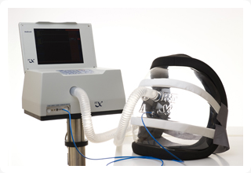
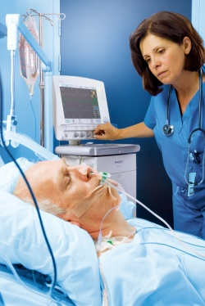
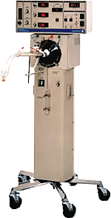
Types of Mechanical Ventilation
Very BIG and hefty, we use positive ventilation instead!
Negative Pressure Ventilation
Attempts to mimic function of respiratory muscles during normal spontaneous breathing
Positive Pressure Ventilation
Mechanical ventilator pushes air into patient’s lungs via tube or mask
High Frequency Ventilation
High Frequency Jet Ventilation (HFJV)
High Frequency Oscillation
(HFO)
Shake very small amounts of tidal volume, but very fast → used is extremely sick patients
Majority of patients will be using positive ventilator

Slide 23
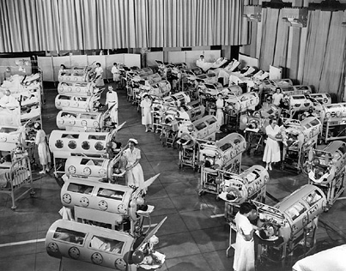
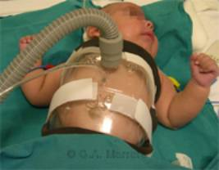
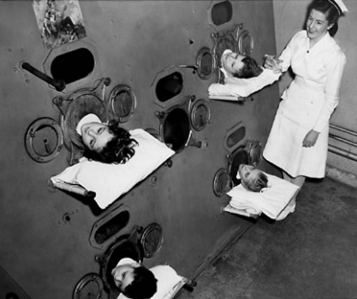
Negative Pressure Ventilation
Either the thoracic area or the entire body is encased in airtight container that is exposed to negative pressure (less than ambient pressure)
Negative pressure transmitted across chest wall into intra-alveolar space and establishes a pressure gradient which allows air to move into the lungs
Chest Cuirass
NPV still has a role as a non-invasive mode of ventilation for some patients.
“Iron Lung” widely used during 1928 polio epidemic
Very limited, cant move much! Not good! Negative pressure will suck air out.

Slide 24
Positive Pressure Ventilation
Positive pressure ventilation occurs when a mechanical ventilator blows air into the patient’s lungs (invasively or non-invasively).
The lungs are, from the ventilator’s point of view, balloons that are inflated and allowed to deflate.
The ventilator must overcome the work required to inflate the lungs. This work is related lung characteristics:
Compliance or stiffness of the lungs. The less compliant or “sick” lung is more difficult to inflate and requires more work from the ventilator
Resistance to the flow of air, mainly due to resistance of conducting airways.
To inflate, you will need to do the work to fill the balooon! Compliance is important! The extremes are hard to inflate, in the middle it is easy
You want the lungs to be as compliant as possible
You want to lower resistance
Normal
Decreased
Compliance
Increased Resistance

Slide 25
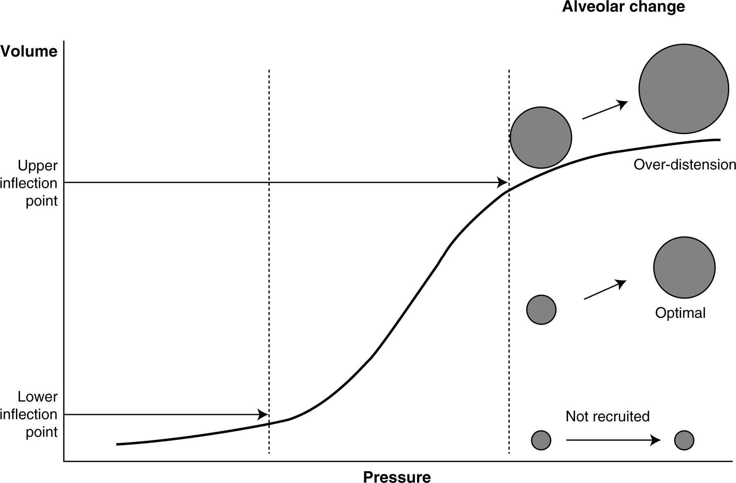
Pressure- Volume Curve (Compliance)
To prevent ventilator induced lung injury the goal is to maintain alveolar recruitment at the lower inflection point and optimize inflation without overdistension.
= the most volume change for the least amount of pressure change.
Alveolar Volume
Volume
Pressure
Easy to ventilate someone in the middle of this curve

Slide 26
Lung Compliance
V
?
V
P
P
Lung A
Lung B
Is Lung A or Lung B more compliant?
Can you think of conditions that would reduce compliance of the chest wall and or the lungs?
YOU CAN HAVE CONDITIONS WHERE THE LUNG IS TOO COMPLIANT! Emphysema
B is more compliant!
Chest wall – deformities, muscle atrophy
Lungs – fibrosis, ARDS, edema, pneumonia/inflammation
Notes:
B more compliant
Chest wall – deformities, muscle atrophy
Lungs – fibrosis, ARDS, edema, pneumonia/inflammation

Slide 27
MV Terminology
RR Respiratory Rate (breaths/minute)
VT Tidal Volume (~4-6 ml/Kg)
VE Minute Volume (RR x VT in L/min)
PIP Peak Inspiratory Pressure (cmH₂O)
PEEP Positive End Expiratory Pressure (cmH₂O)
MAP Mean Airway Pressure (cmH₂O)
Ti Inspiratory Time (s)
Trigger Sensitivity
PS Pressure Support (cmH₂O)
FIO₂ Fraction of Inspired Oxygen
Tidal volume Normal amount of air going in/out of lungs when breathing quietly
PIP→ amount of pressure delivered at the end of inspiration
PEEP: When you expire, how much pos pressure is still remaining in lung (to prevent from collapsing)
MAP is mean between PIP and PEEP
Ti: how long does it take you to breath air in
Trigger sensitivity: sensitivity of ventialltor to detect if pt is trying to breath
Pressure support: diference between PIP and PEEP
Fi O2: fraction of inspired o2

Slide 28
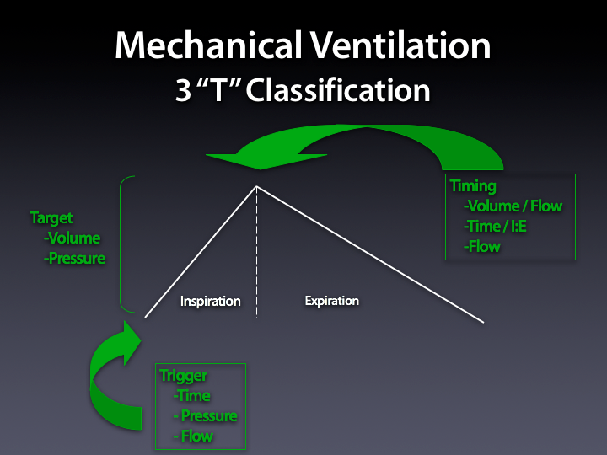
Modes of Ventilation – the bottom line!
When you ventilate someone, you cnan control 3 things
Modes of ventilation describe how the ventilator controls breath delivery.
The simplest way to classify the mode is to remember the 3T’s:
Trigger refers to how the breath is initiated or what tells the ventilator to start inspiration.
Target refers to set volume or pressure the ventilator will try to deliver.
Timing refers to set value that determines when to terminate inspiration.
Once these are determined you will know what parameters are being set or controlled and what measured values you should be monitoring.

Slide 29
Pressure and Volume Modes of Ventilation
 | Pressure Control | Volume Control
What you set | RR PIP PEEP | RR Vt PEEP
What you can monitor | Vt Delivered If your tidal volume decreases, what do you think is happening? | PIP Measured What do you think an increase in measured airway pressure indicates?
In every mode of ventilation there are ALARMS set to keep patient safe.
2 types of ventilatoors
Pressure control: you set the RR, pip and peep. You measure how much volume is delivered
In volume controL: you set those things, and you measure the PiP!!!! So what happens is lets say you are a pressure control ventilator, and all of a sudden, TIDAL VOLUME starts going down! THE PT IS GETTING STIFFER! SAME AMOUNT OF PRESSURE IS CAUSING LESS CHANGE IN VOLUME! PT IS GETTING SICKER
If ventilator is supposed to give a certain amount of Vt, but over time the pressure goes up. This is also an issue! Because it takes more pressure to bring in that same amount of volume
Notes:
Increase in Vt delivered may mean increased compliance, decreased resistance, or be a reflection of patient effort. (may be able to reduce PIP)
Increase in PIP with Volume ventilation may mean decreased compliance, secretions, increased resistance and or an obstruction in the ventilator tubing. Recruit? Investigate, suction, CXR, adjust Vt set and increase rate if necessary to maintain minute ventilation.

Slide 30
What kind of breaths does the ventilator deliver?
Ventilator mode may be either one of or a combination of the following:
Mandatory or Controlled breaths
Machine triggered and timed
Anesthesia or critical care with very sedated patients
This mode is NOT comfortable for a responsive alert patient
Assisted Breaths:
Patient triggers the breath but timing of inspiration is determined by the machine
Acute or chronic care applications
Support Breaths
Patient triggered
The ventilator responds to patient demand and lets patient determine length of inspiration and timing of expiration.
Used to wean from mechanical ventilation or to provide long term support in patient with intact respiratory drive
Ventilators can have many different types of modes:
Mandatory/controlled breaths → only used in anasthesia or if pt cant breath alone. Or else can be uncomfortable
Assisted: when I breath, it helps me!
Supported breaths: wanna use when someone is being weened off ventilator (how long the person breaths in is up to the pt!!! Must have intact resp drive! Pt must decide when to breath!

Slide 31
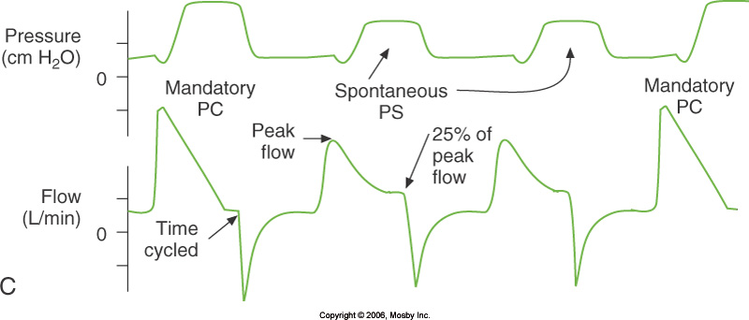
SIMV with PEEP and PS
Synchronized intermittent mandatory ventilation with PEEP and pressure support
is a very common mode used in many critical care units for patients who are even
slightly aware. By synchronizing the machine breaths with patient effort and
allowing for spontaneous breaths the patients is much more comfortable.
Most common types of ventilator modes:
SIMD → if pt is slightly aware, this allows for both mandatory and voluntary breaths. So the machine is setting a rhythsm for you, but If pt is breathing faster, and he goes independently than the machine, the machine will simply support instead of triggering.

Slide 32
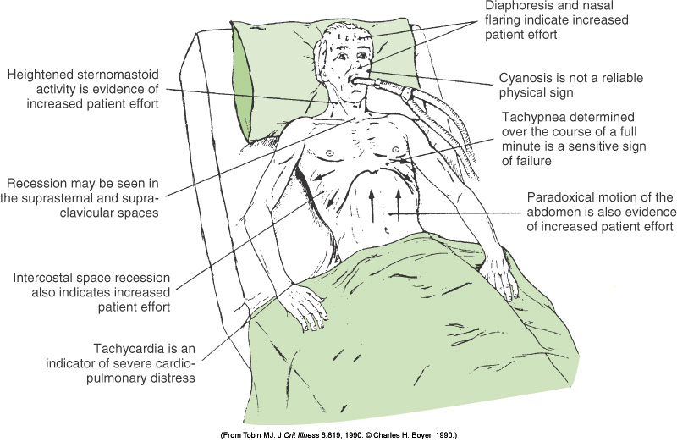
Monitoring
Observe and Assess with your own eyes!
Must monitor the pt to see if the ventilation is working well! Must look at the pt
Accessory muscle use
Tachypnea
If ventilator is working against the pt, you ewill get PARADOXICAL breathing
Cyanosis (rare/late)
Diupheresis
Nasal flaring
[Unit name – Lecture title – Prof name]

Slide 33
Controlling the Patient’s PCO₂
.
How do you ventilate someone when your goal is to decrease their CO2 levels?
There is a direct inverse relationship between rr and co2 (if you double their RR, you will half their CO2 →simple!!!)
.
PaCO₂ α Patient’s production of CO₂ (VCO₂)
Ventilation (V_{E})
Ventilation = Respiratory Rate x Tidal Volume (VT)
Patient’s PaCO₂ can be controlled by adjusting respiratory rate or tidal volume
Given simple, inverse relationship, doubling Respiratory Rate or tidal volume will halve patient’s PaCO₂
Notes:
Inspiratory Pressure generated by ventilator is determined by inspiratory flow, which is governed by airway resistance and inspiratory time

Slide 34
Controlling the Patient’s PaO₂
Fraction of inspired oxygen (FiO2)
Positive End Expiratory Pressure (PEEP)
Brings functional residual capacity to more optimal portion of flow-volume curve
Relieves airway obstruction
3. Mean airway pressure
Increasing total amount of oxygen in lungs for capillaries to uptake
Improving Ventilation-Perfusion matching
Reducing shunt
Recruiting collapsed alveoli
Compliance
Controlling the pt O2 is a bit harder to measure quantitevely
fio2 → if you have an open system (hard to monitor), if closed system (easy to monitor
PEEP: use pos pressure to open up alveoli
Mean Airway pressure: increase amount of o2, improve VQ, etc.

Slide 35
Respiratory Complications of Mechanical Ventilation
Downsides of mechanical ventilation!
Lung Injury from high FiO₂, barotrauma/high ventilator pressures
Pneumothorax
Adult Respiratory Distress Syndrome, permanent lung damage (uncommon)
Ventilator-Associated Pneumonia
Bypass normal upper airway defenses
Defeats laryngeal function, so increased risk of aspiration of saliva, gastric contents
Colonization of upper and lower respiratory tract by bacteria living in the ICU, moist places (e.g. ventilator tubing)
Airway Complications
Mucous plugging (endotracheal and tracheostomy tubes act as airway irritants, and generate mucous, reduced humidification of secretions)
Sinusitis (endotracheal tube interferes with normal sinus drainage)
Laryngeal or tracheal injury from tube leading to bleeding, scarring, vocal cord paralysis

Slide 36
Non-Respiratory Complications
Cardiac Complications
PEEP interferes with venous return to the right heart, reducing cardiac output and oxygen delivery to the tissues
Immobilization increases risk of deep venous thrombosis
Neurological
Intubation interferes with speech
Anxiety
Muscle relaxants can cause persistent peripheral muscle weakness
GI
Increased risk stress ulcers, gastrointestinal bleeding
Gastric distention from air can cause vomiting

Slide 37
Helping a Ventilator Work Less Hard (1)
Sedation
Necessary for comfort
Mainly opiates (morphine), benzodiazepines
Reduces ventilator-patient asynchrony (patient “fighting” the ventilator)
Essentially all are respiratory depressants
Muscle relaxants
Abolish chest and abdominal wall and respiratory muscle tone
Mainly curare derivatives
Reduce chest wall (and therefore respiratory system) compliance
Eliminates patient “fighting” the ventilator
Necessary for most surgery, if ventilation being used during general anesthesia
Mandates ventilatory support

Slide 38
Helping a Ventilator Work Less Hard (2)
Exogenous Surfactant
Improves lung compliance (neonates)
Given by dripping down endotracheal tube
Inhaled nitric oxide
Improves ventilation-perfusion matching and oxygenation, reduces pulmonary hypertension
Prone Positioning
Improves diaphragmatic excursion
Improves ventilation-perfusion matching
May complicate nursing care
Airway Suctioning and Chest Physiotherapy
Clear secretions, mucous plugs for airways
Prevent and treat atelectasis
Very strong vasodilator

Slide 39
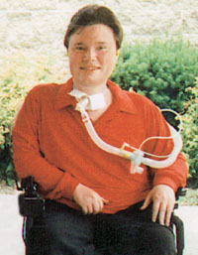
Home Ventilation via tracheostomy
May allow patients with chronic respiratory failure many additional years of life outside the hospital
Many tracheostomy patients able to speak, eat with newer techniques
Many ethical implications
Quality of life
Studies show chronically ventilated patients consider their quality of life to be better than their caregivers would predict
Need for Nursing and Respiratory Therapy Support
Risk of disconnects, mucous plugs
Need for suctioning, monitoring and alarms
Privacy Concerns
Costs

Slide 40
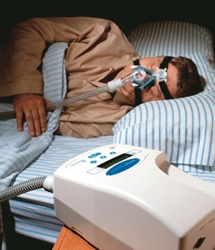
Non-Invasive Ventilation

Slide 41
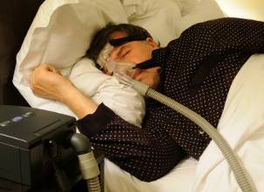
What’s Non-Invasive Ventilation?
Mechanical ventilation without use of an endotracheal or tracheostomy tube
Requires:
Headgear (usually Velcro straps) to tightly apply mask to face
Nasal & full face interfaces - interfere with speech, eating, to generally suitable only for night-time use
Small, portable electrical devices, to fit on bedside table; simple to operate & maintain
Humidifiers to improve patient comfort
Headgear
BiPAP or CPAP device
Mask interface
Very simple!
CPAP → keeps the airway open, not really a ventilator (it gives continuous air to keep straw open, prevents the soft tissues from collpapsing (it is continuous air given, same as PEEP)
BiPAP: you have 2 pressures, you have first of all the PEEP pressure (Same as cpap), but you also have an inspiratory helper! It also has a backup RR giver (it is like a pacemaker for respiratory rate in case you slow down your breathing

Slide 42
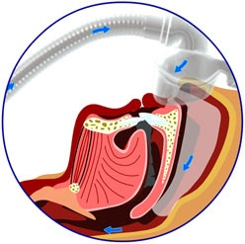
CPAP Continuous Positive Airway Pressure
Pneumatic Splint
Works by creating a "pneumatic splint" for the upper airway, preventing the soft tissues of the upper airway from narrowing and collapsing.
Pressurized air is sent from a flow generator through air tubing and a mask to the face - through to the upper airway.
The air passes through the nose and into the throat, where the slight pressure keeps the upper airway open.
ResMed.com
CAP is continuous air supply to prevent collapsing!
Notes:
42

Slide 43

BiPAP Therapy
Delivers 2 pressures: more positive pressure during inspiration (PIP) and less pressure during exhalation (PEEP)
Sensor detects onset and duration of each breath, like pressure support
Pressure differential (PIP – PEEP) means that device delivers a tidal volume with each breath, so machine can also be used to ventilate someone
Can use in ICU for non-invasive ventilation for patients in mild respiratory failure, or at home for home nighttime ventilation for nighttime respiratory failure
Built-in Backup Rate, so delivers breaths if patient develops central apnea
System intrinsically leaky, so can’t deliver high pressures, minimal or no ventilator alarms
BiPAP is 2 pressures given
Same pressure as CPAP → keep airway open
A helper for inspiration (adds pressure whenever you inhale!
IT ALSO HAS A BACKUP SYSTEM, RR PACEMAKER! Not perfect but it is good, bit more secure than a CPAP.
Notes:
43

Slide 44
Complications of Positive Airway Pressure Devices
Compliance with long-term use < 50%
Interfere with sleep, positioning, noise, difficulty exhaling and unusual sensation inhaling, claustrophobia
Drying of airway (prevent with humidification)
Perception it interferes with intimacy, but bed partners often prefer use of device, as snoring/apnea much less loud
Perceived benefits (daytime functioning, cardiovascular health etc.) may be subtle
Complications – fairly similar to invasive ventilation, but milder
Facial, nasal pressure sores from mask common
Dry nose & throat, nosebleeds, eye irritation from airflow around mask
Gastric distention from air
Gastric distension 00> air going into stomach
Most patient don’t actually use it much! It can interfere with sleep! There is a lot of air hitting your face! Only patients that think it is working will use it!

Slide 45


Why Care About Non-invasive Ventilation?
25% of Canadians and 33% of Americans are obese
Rate increased 300% 1981-2001 Canadian children
Public Health Agency of Canada, 2009
Number of CPAP devices United States (2006): 20 Million
Rise in CPAP prescriptions per year (United States): 18%
CPAP sales (United States, 2006): $2.4 Billion per year
http://www.prwebdirect.com/releases/2008/6/prweb1006354.php

Slide 46
QUIZ TIME

Slide 47
Which therapy would you use for this patient?
18 year old with Duchenne Muscular Dystrophy and nocturnal hypoventilation
BiPAP → non invasive approach, you don’t need to go too full out because it is only an issue at night
Not cpap: because his muscles are weak! So cant inhale well!

Slide 48
Which therapy would you use for this patient?
50 year old obese man with obstructive sleep apnea
Cpap → keep airway open!
No need for tracheostomy!

Slide 49
Conclusion
Home oxygen readily available (less in rural areas), but must be sensitive to patient’s needs
Using mechanical ventilators is based on understanding of basic respiratory physiology
Quite predictable effects on gas exchange
Ethical issues in patients unable to wean from ventilator in acute care setting, initiation of long-term ventilation
Risk of complications much higher with invasive ventilation than non-invasive ventilation
Home CPAP, BiPAP, Home O2 use increasingly common – community physicians need to be familiar with these devices!

